Slide 1

IOT BASED AUTOMATIC
WET GRINDER

Slide 2

GUIDE: Mr. E. VENUGOPAL
TEAM DETAILS:
NAME | DEPART MENT | YEAR
RISHVANA.M | ECE | III
SASMITHA.V | ECE | III
SANTHOSH KUMAR.B | ECE | III
RUTHRA PRAKASH.S | ECE | III

Slide 3
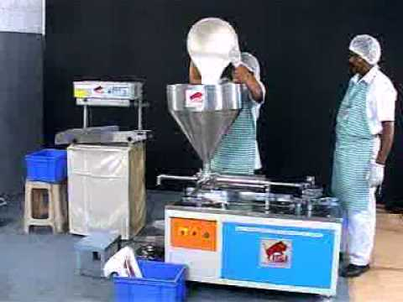
EXISTING PROBLEMS
Manual intervention is needed in all stages of batter preparation
Cleaning process creates skin problems
Lack of customization in the various types of batter
Lack of remote motoring

Slide 4
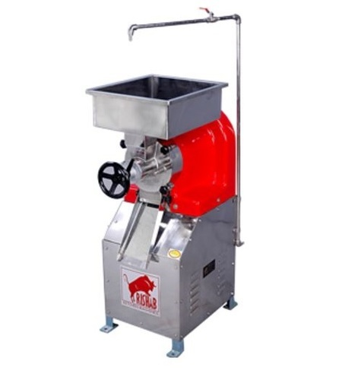
EXISTING SOLUTION
Semi Automatic grinder in food industries

Slide 5
PROPOSED SOLUTION
South India is famous for traditional food like Idli, and Dosa.
Most of the people prefer batter based food for their breakfast and dinner.
But people are finding difficulty in preparing batter in their home. This is because, batter preparation is time consuming process and lack of experience.
Small scale industries are using this opportunity to make of it. They are involving in preparing packet batter.
To overcome these problems, we are introducing IOT BASED FULLY AUTOMATED WETGRINDER USING PLC

Slide 6
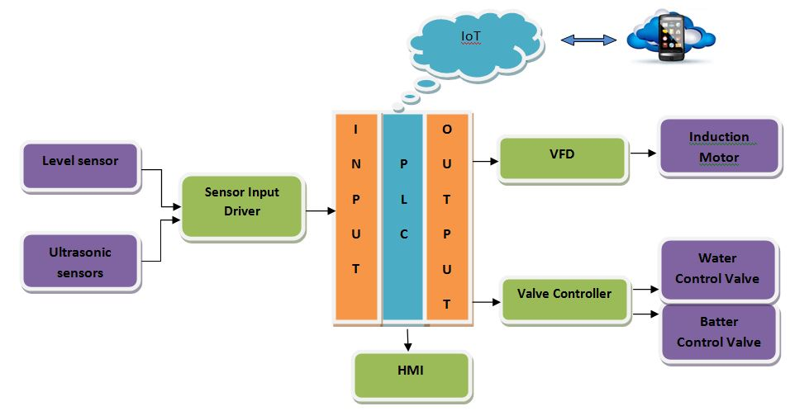
BLOCK DIAGRAM

Slide 7
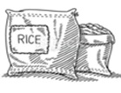

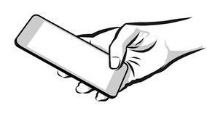

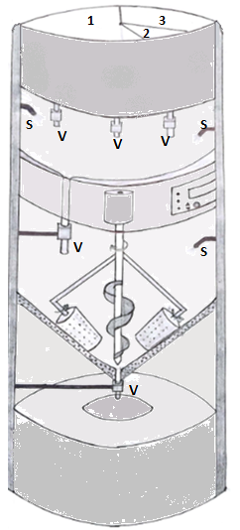


IOT Based Automatic
Wet Grinder
a
a - - Storage chamber
b - - Soaking chamber
c - - Display and control unit
d - - Vertical grinding chamber
e - - Collecting chamber
V - - Valve
S - - Sprayer
IM - - Induction Motor
b
c
IM
d
PLC CONTROLLER
e

Slide 8
EXPLANATION OF THEME
This product is fully Automated wet grinder. It is not available in the market.
Reduction of manual work makes it to capture the market
Auto cleaning process reduces the water consumption and easy supervision
With a single machine, we can make various types of batter
Innovation in machine design makes it to be preferable by the customers
Due to IoT inclusion, the machine’s operation and batter parameters can be visualized

Slide 9

INNOVATION
A non available customized batter preparation machine
Remotely operated machine (IoT)
Valve is placed in the bottom of the grinding chamber makes batter preparation process easier
The preferences to the batter selection is implemented through Mobile Application using IoT
Auto-cleaning process makes uniqueness in batter preparation
IOT
PLC
AUTOMATIC WET GRINDER

